Slide 1

Predicting Salaries
Aishwarya Bhethanabotla and Katherine Shagalov
Notes:
Role-Based Aggregates: Calculate median and average values (e.g., salary, overtime hours) within each job title to establish benchmarks that capture typical salary patterns for each role.
Seniority Indicators: Create features that indicate supervisory roles or seniority within job titles, helping the model differentiate between varying levels of responsibility and experience within similar roles.
Categorical Encoding Enhancements: Use advanced encoding techniques, like target encoding or frequency encoding, to represent categorical variables (e.g., job title, location) with more nuanced values that capture average salary influences within each category.
Temporal Indicators: Generate features to capture seasonal or tenure-based patterns, such as quarters of service or time of hiring, to identify potential seasonal effects on pay.
Workload Ratios: Create ratio-based features that quantify an employee’s workload and additional compensation relative to base salary, highlighting the impact of overtime or extra duties on total earnings.
Historical Growth Trends: For roles with multiple years of data, calculate salary growth rates or average yearly increases by job title to reflect progression patterns over time.
Location-Based Adjustments: Adjust for regional cost-of-living differences by adding location-based adjustment factors, ensuring that salary predictions account for economic variability across different locations.
Interaction Features: Combine key variables, such as job title and employment status, to capture the nuanced effects of specific statuses (e.g., on leave, active) within different roles, improving model sensitivity to role-specific salary variations. pwhi

Slide 2
Table of Contents:
Problem Statement & Objective
Data
Data Pre-Processing/ETL
Solution
Metrics to track performance of solution
Scaling up and scaling out strategies
Conclusion

Slide 3
Problem Statement & Objective
Problem Statement
In a rapidly changing job market, salaries vary significantly based on factors like experience, job responsibilities, company, and location. This variability makes it difficult for employers to plan payroll accurately and for job-seekers to gauge fair compensation, resulting in challenges for effective salary benchmarking and budgeting.
Objective
This project aims to create a predictive model to estimate salaries for agency employees using historical payroll data. By analyzing factors such as employment status (active, on leave, or ceased), job title, work location, and hours worked, the model will forecast salaries to help with payroll planning and budgeting. The insights from this model will highlight key factors that influence pay, helping to improve payroll management and identify trends in compensation across different job roles and boroughs.

Slide 4
Data and Structure
Data gathered from NYC OpenData Citywide Payroll Data (Fiscal Year). Contains 6.22 million rows.
Fiscal Year Fiscal Year
Payroll Number Payroll Number
Agency Name The Payroll agency that the employee works for
Last Name Last name of employee
First Name First name of employee
Mid Init Middle initial of employee
Agency Start Date Date which employee began working for their current agency
Work Location Borough Borough of employee's primary work location
Title Description Civil service title description of the employee
Leave Status as of June 30 Status of employee as of the close of the relevant fiscal year: Active, Ceased, or On Leave
Base Salary Base Salary assigned to the employee
Pay Basis Lists whether the employee is paid on an hourly, per diem or annual basis
Regular Hours Number of regular hours employee worked in the fiscal year
Regular Gross Paid The amount paid to the employee for base salary during the fiscal year
OT Hours Overtime Hours worked by employee in the fiscal year
Total OT Paid Total overtime pay paid to the employee in the fiscal year
Total Other Pay Includes any compensation in addition to gross salary and overtime pay, ie Differentials, lump sums, uniform . allowance, meal allowance, retroactive pay increases, settlement amounts, and bonus pay, if applicable.

Slide 5
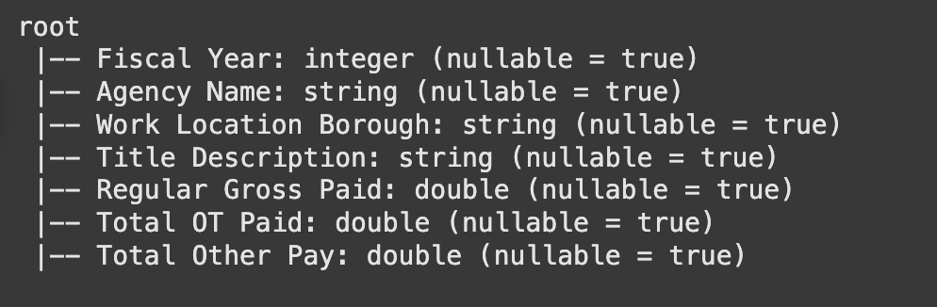
Data Pre-Processing
Cleaning & Transformation
Dropped unneeded columns
Name data (First, Last, MI)
Payroll Number
Leave Status
Agency Start Date
Regular Hours
Overtime Hours
Pay Basis (per Annum/per Day/etc)
Filtered out rows with total pay less than 5000
Summary statistics were heavily skewed before this
Removed entries such as Election Workers, part-time education employees, etc

Slide 6
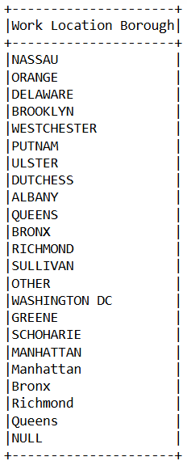
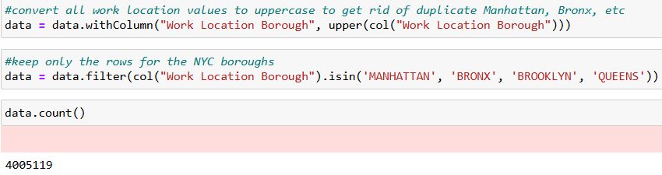
Data Pre-Processing
Filtered Location Borough
Manhattan
Bronx
Brooklyn
Queens

Slide 7
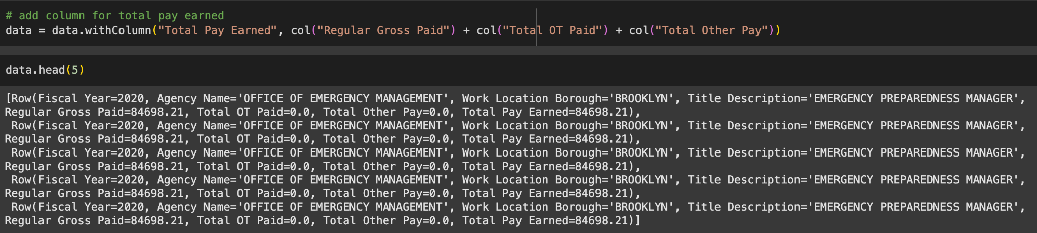
Feature Engineering
Total Pay Earned: Added together the Regular Gross Paid, OT Paid, and Other Pay to get the total amount earned per year for more accurate pay representation. Much better metric since certain roles such as Firefighters, Marine Engineers, etc can make more than 2x salary in OT pay.

Slide 8
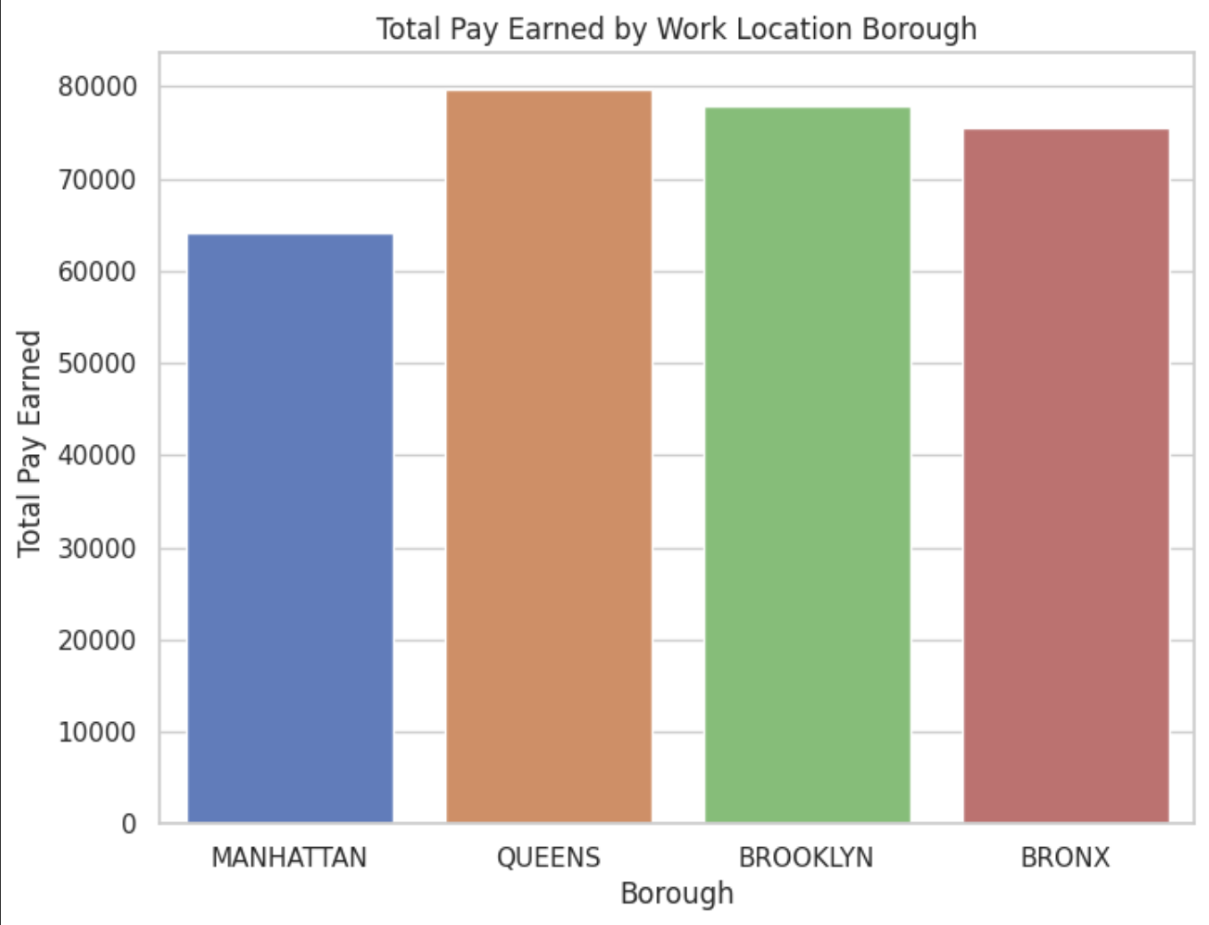
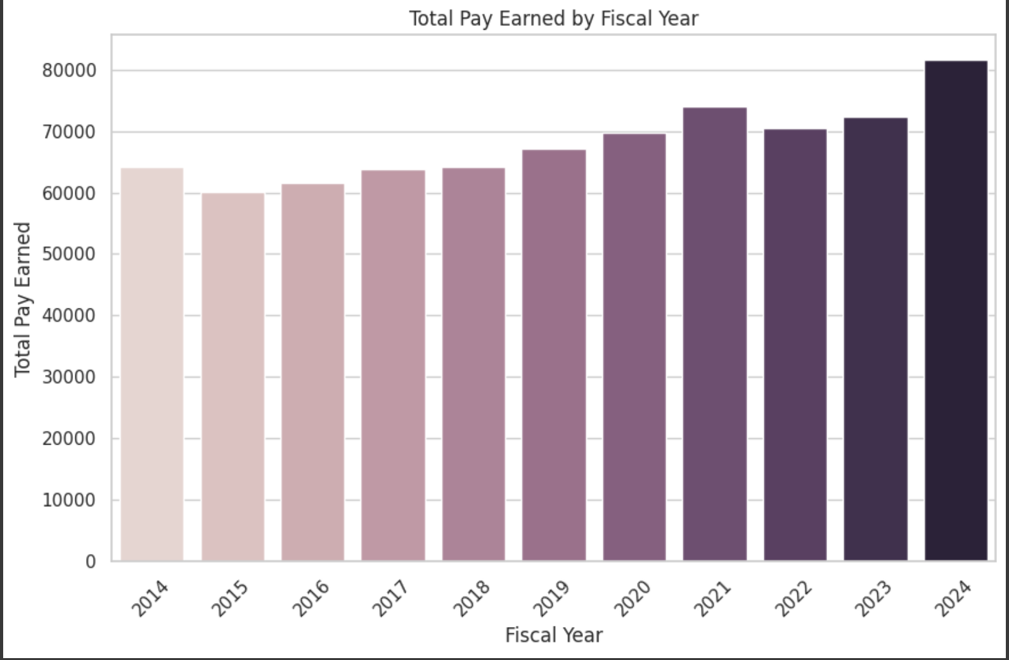
Exploratory Data Analysis
Calculate basic statistics such as mean based on different categories such as location borough and fiscal year.

Slide 9
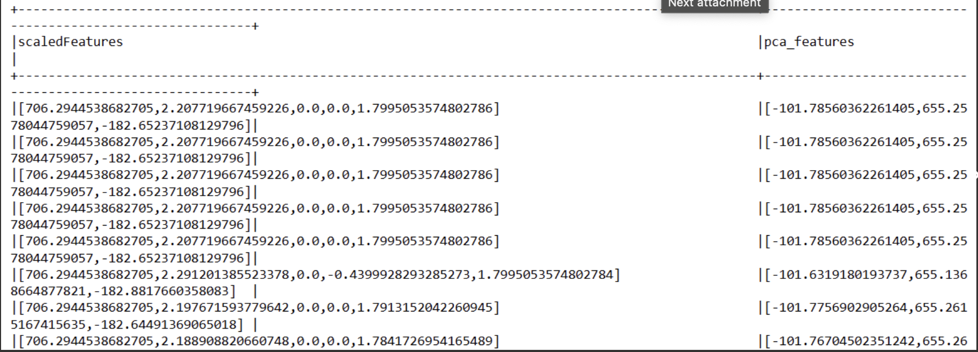
Principal Component Analysis
Compute Principal Component Analysis (PCA) to find most important feature columns
Standardizing Features: Used StandardScaler to scale features since PCA is sensitive to feature scales.
PCA Transformation: PCA converted standardized features into orthogonal components (uncorrelated), eliminating multicollinearity.
Optimal Components: Analysis showed that 3 principal components were optimal, capturing most of the variance while reducing model complexity.

Slide 10
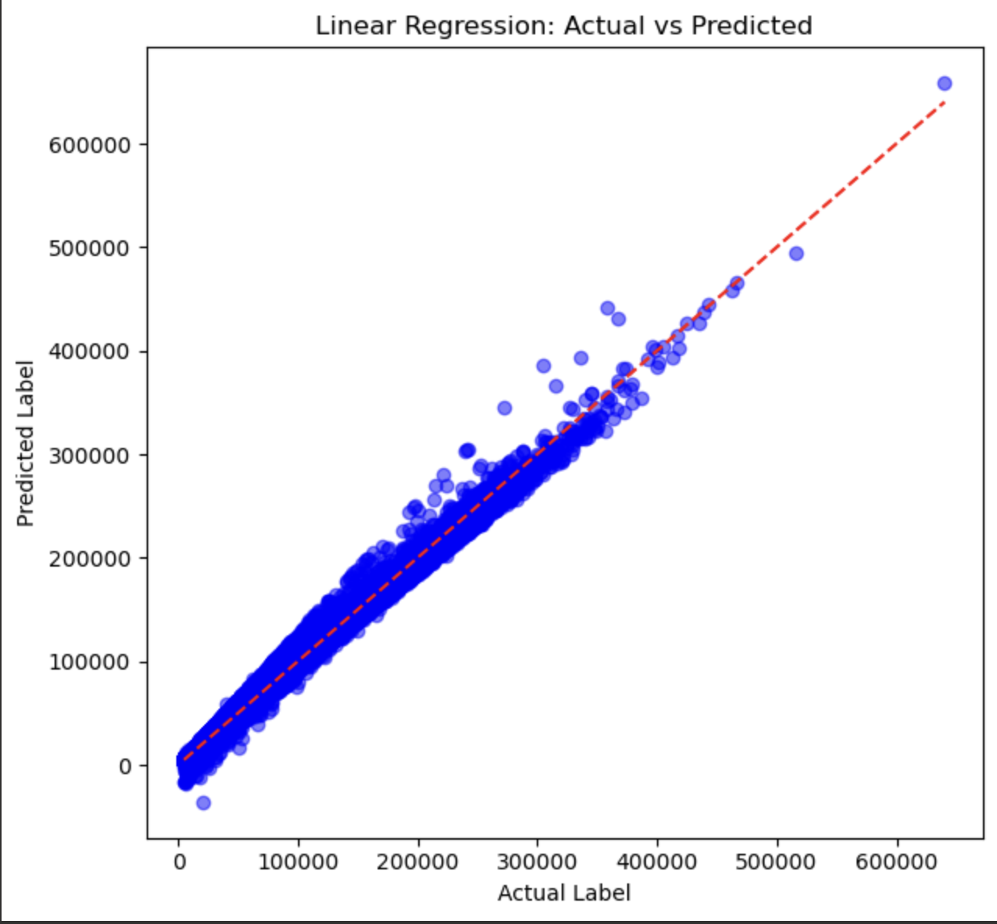
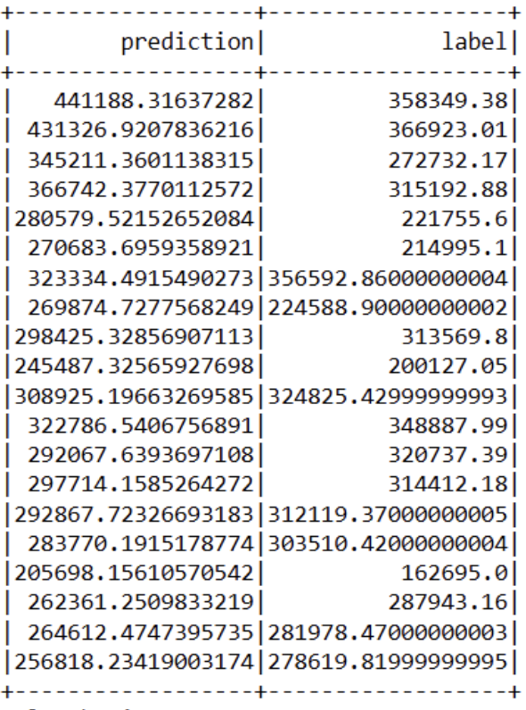
Linear Regression
To highlight any direct linear relationships between features and salary outcomes.

Slide 11
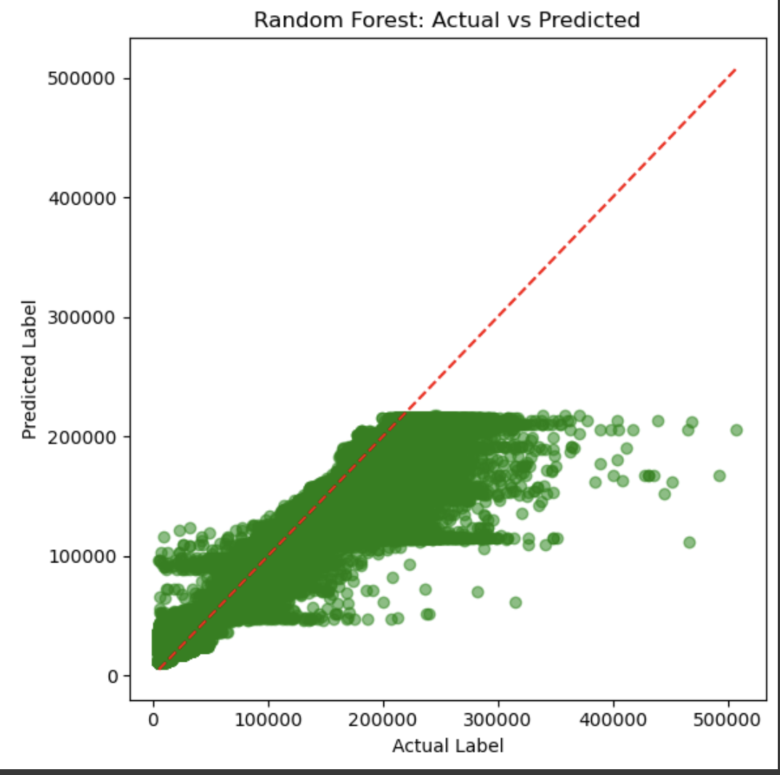
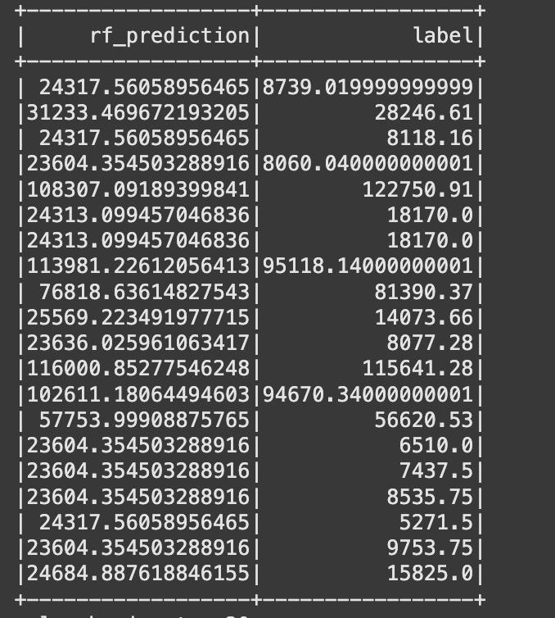
Random Forest
A machine learning algorithm that uses an ensemble of decision trees to improve predictive accuracy and control overfitting.

Slide 12
Performance Metrics of Solution
Model Evaluation
Linear Regression:
MAE: 1068.13 — Represents the average magnitude of errors in salary predictions.
Adjusted R²: 0.9985 — Indicates a strong proportion of salary variance explained by the model, accounting for the number of predictors.
Random Forest:
MAE: 8326.26 — Reflects the average prediction error for salaries.
Adjusted R²: 0.9238 — Shows the variance explained by the model while adjusting for predictors.

Slide 13
Scaling Strategies
Scaling Up: Start with 20% of the dataset and incrementally increase to 40%, 60%, 80%, and 100%, evaluating model performance at each step.
Scaling Out : Gradually increase the cluster size to up to 8 executors, analyzing computational speed and model performance to determine the optimal configuration.
First, we applied Linear Regression, followed by Random Forest.
.

Slide 14
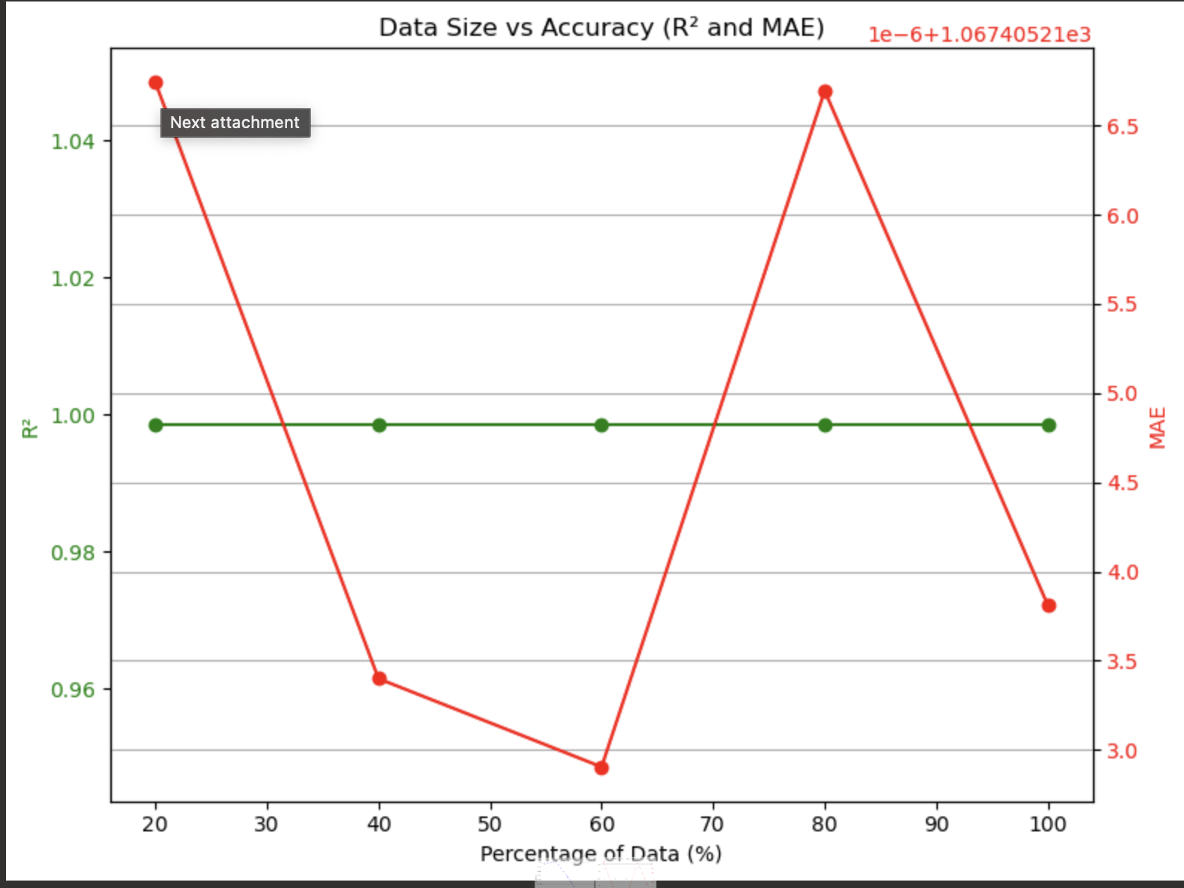
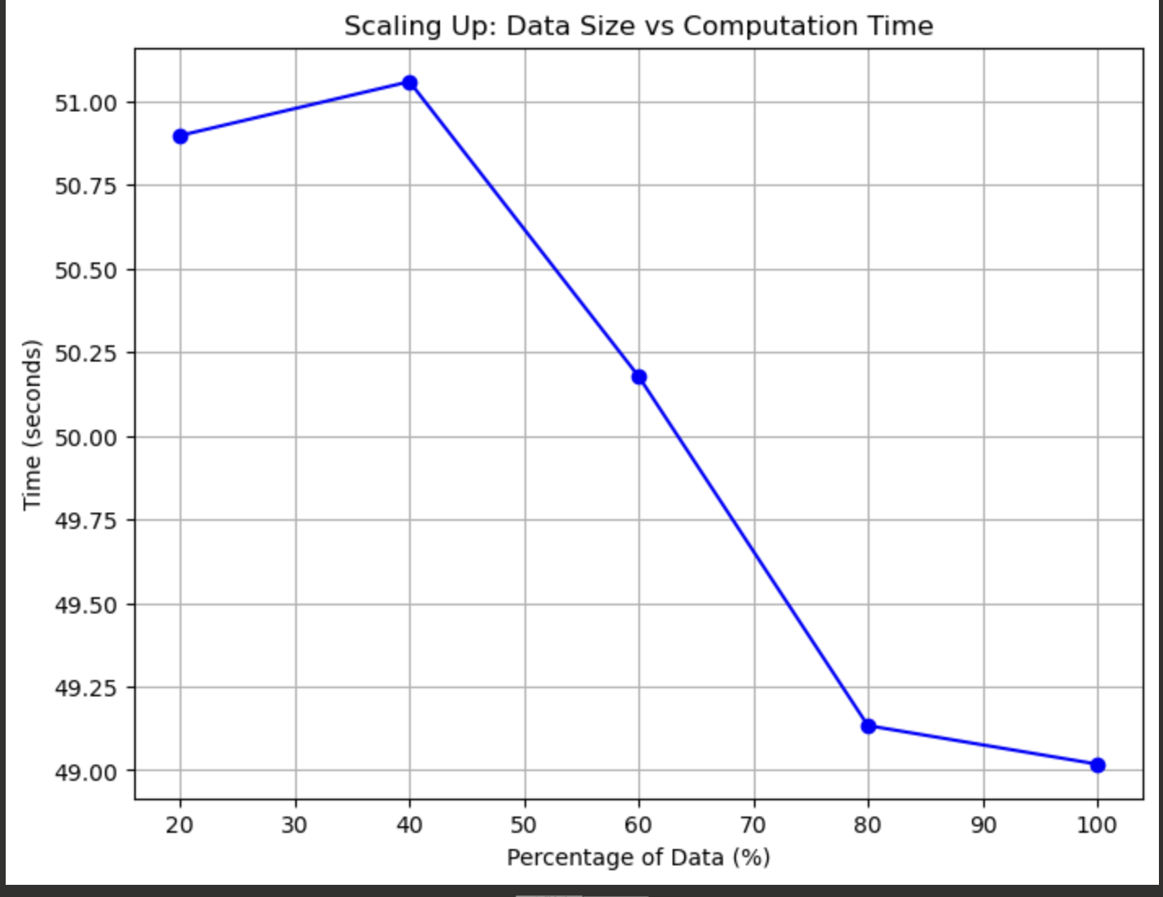
1 Master 2 Workers- Linear Regression
Scaling out:
Scaling up:

Slide 15
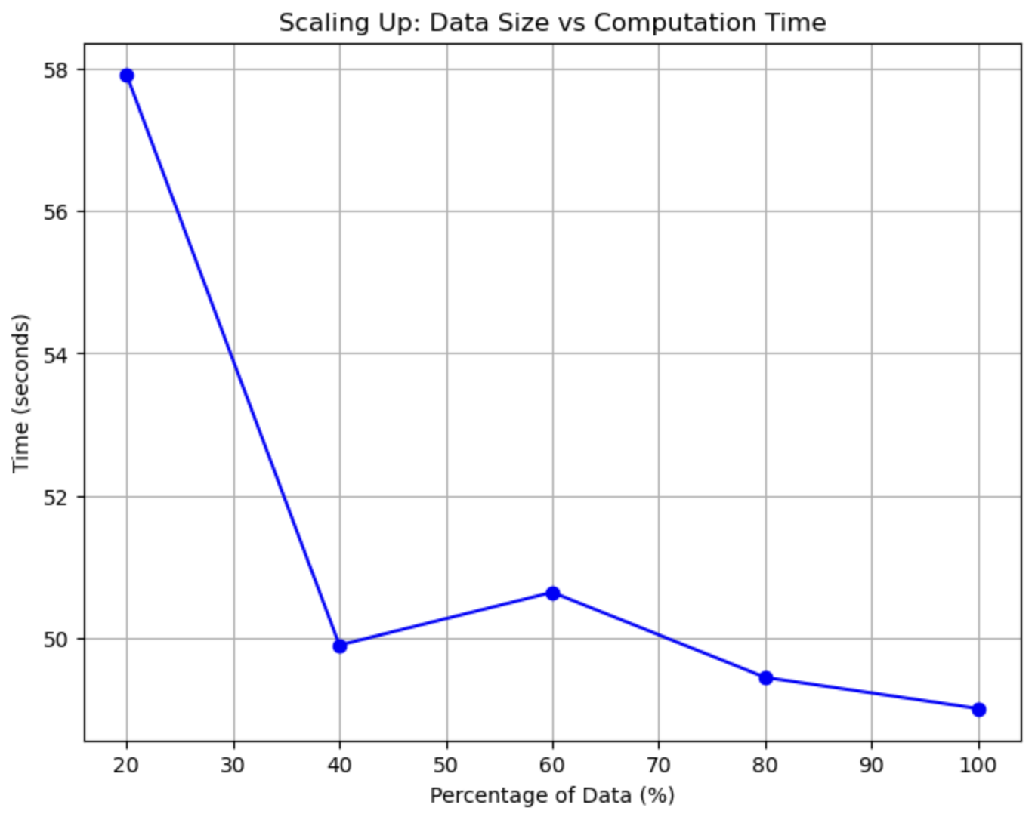
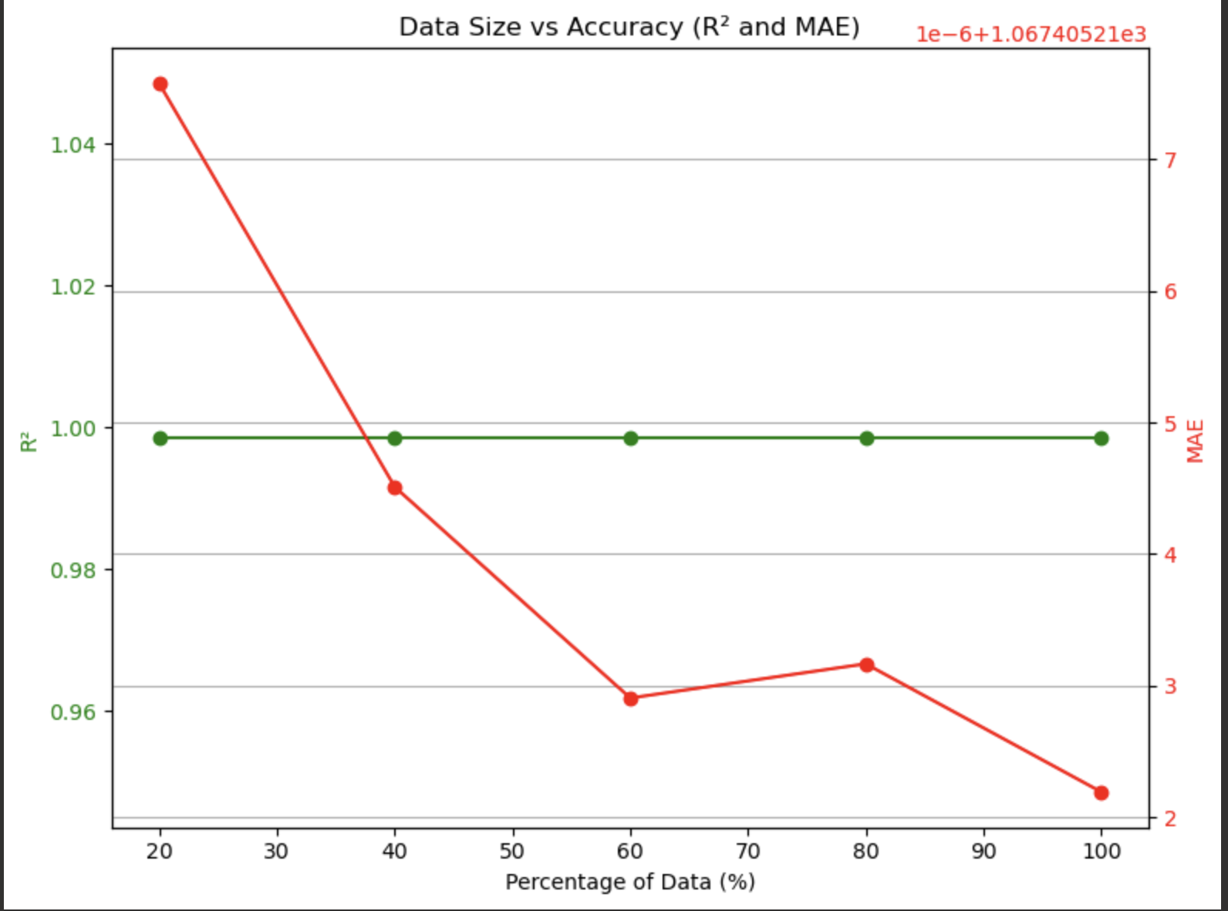
1 Master 3 Workers-Linear Regression
Scaling out:
Scaling up:

Slide 16
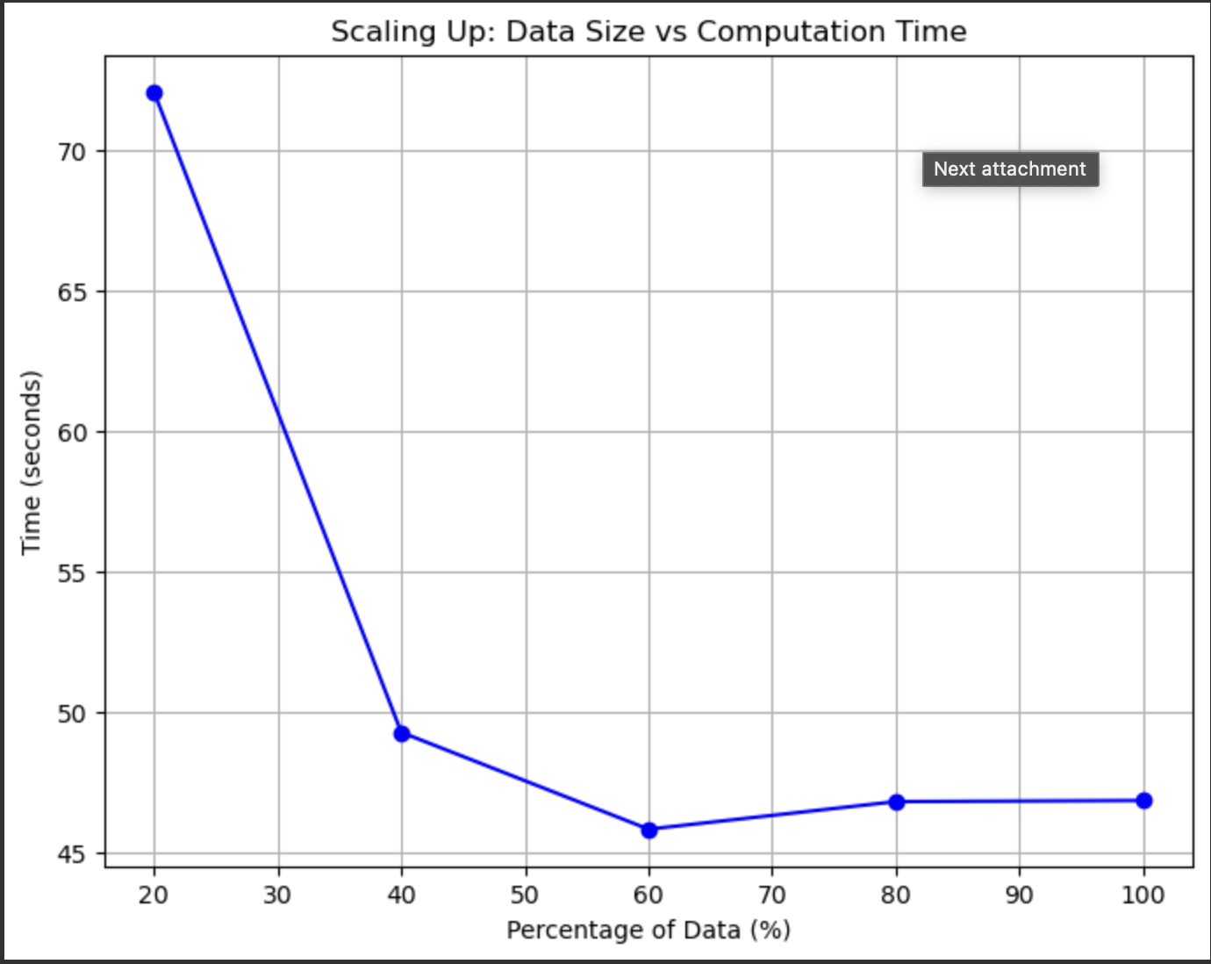
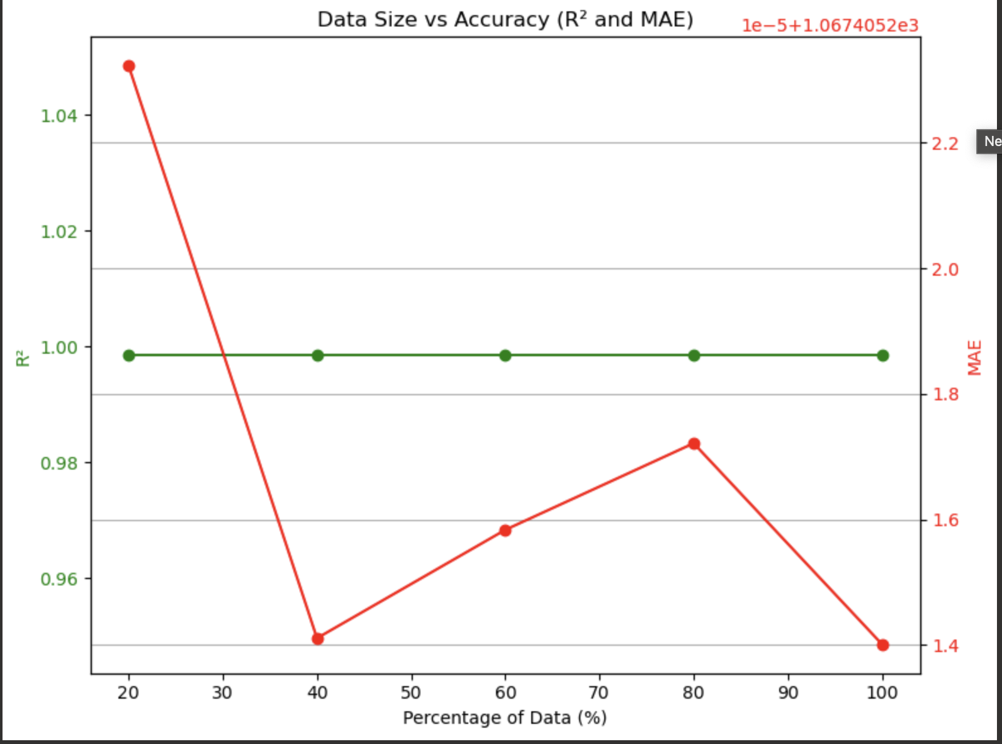
1 Master 4 Workers-Linear Regression
Scaling Out:
Scaling up:

Slide 17
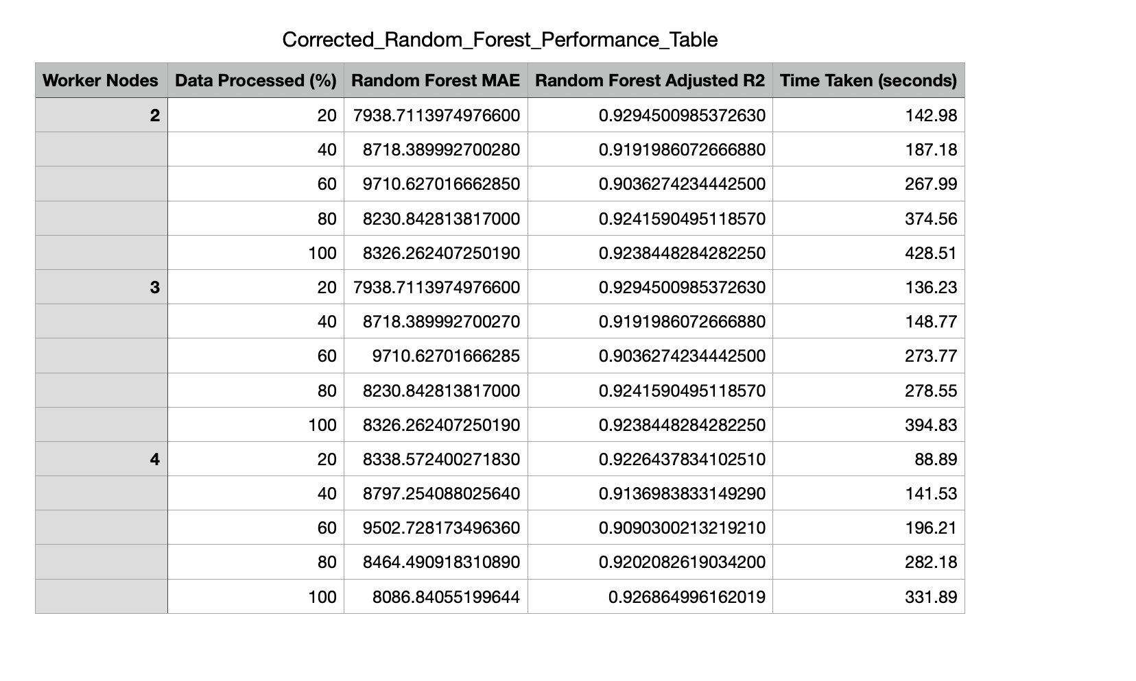
Random Forest
We decided to focus on the Random Forest model over Linear Regression due to its greater sensitivity to cluster size and resource allocation, effectively leveraging distributed computation. We found Linear Regression to be an accurate model but unhelpful for our dataset’s metrics, making Random Forest a better choice for evaluating the trade-offs between computational speed and model performance in distributed environments and providing valuable insights into optimizing configurations for complex models.

Slide 18
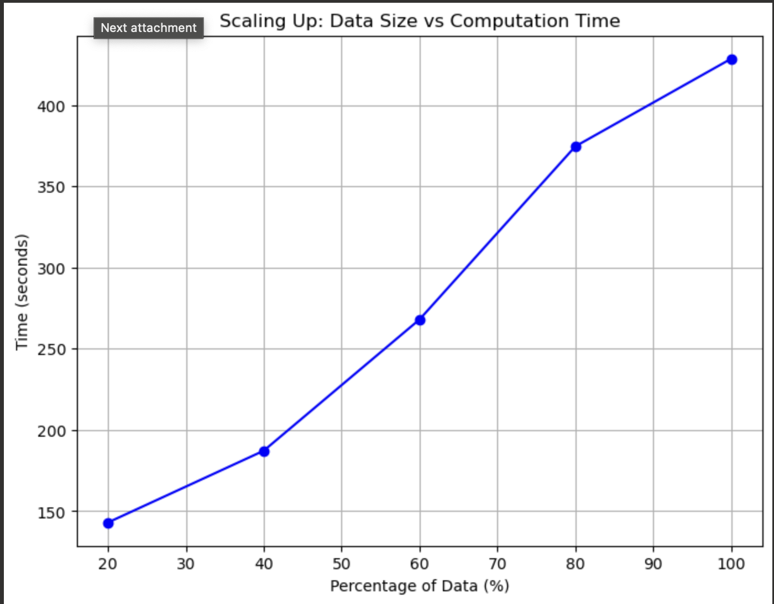
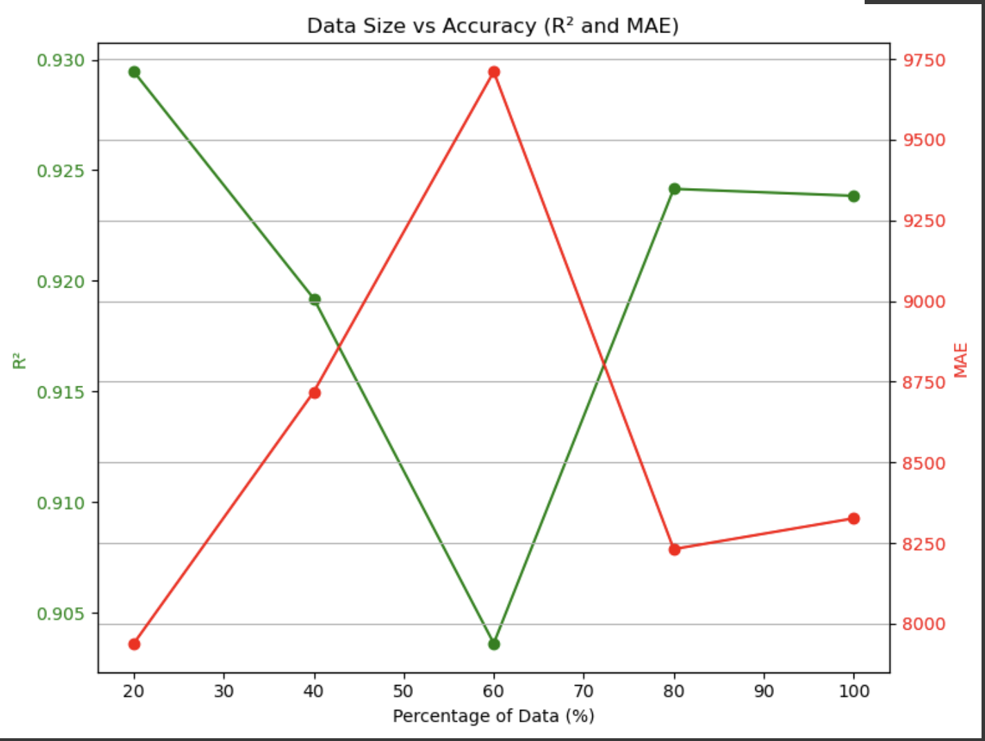
1 Master 2 Workers- Random Forest
Scaling out:
Scaling up:

Slide 19
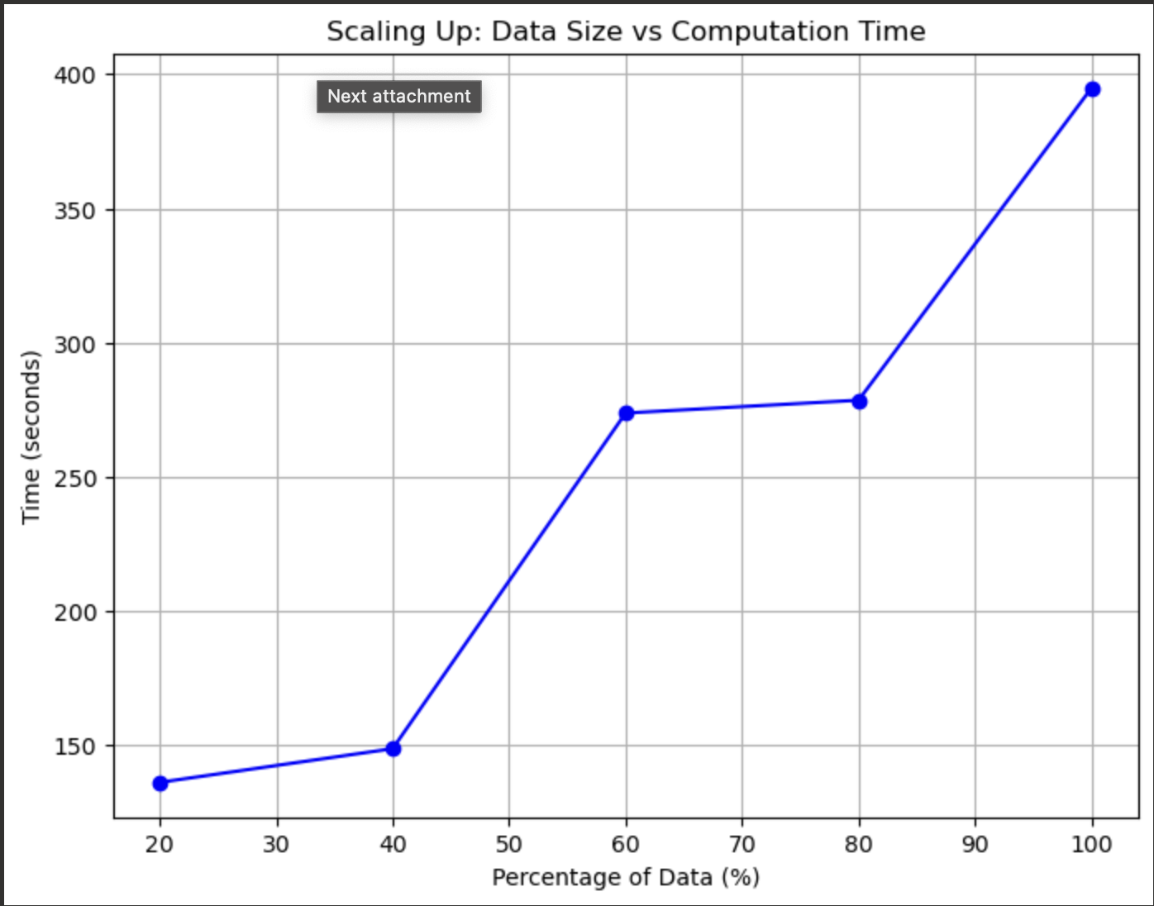
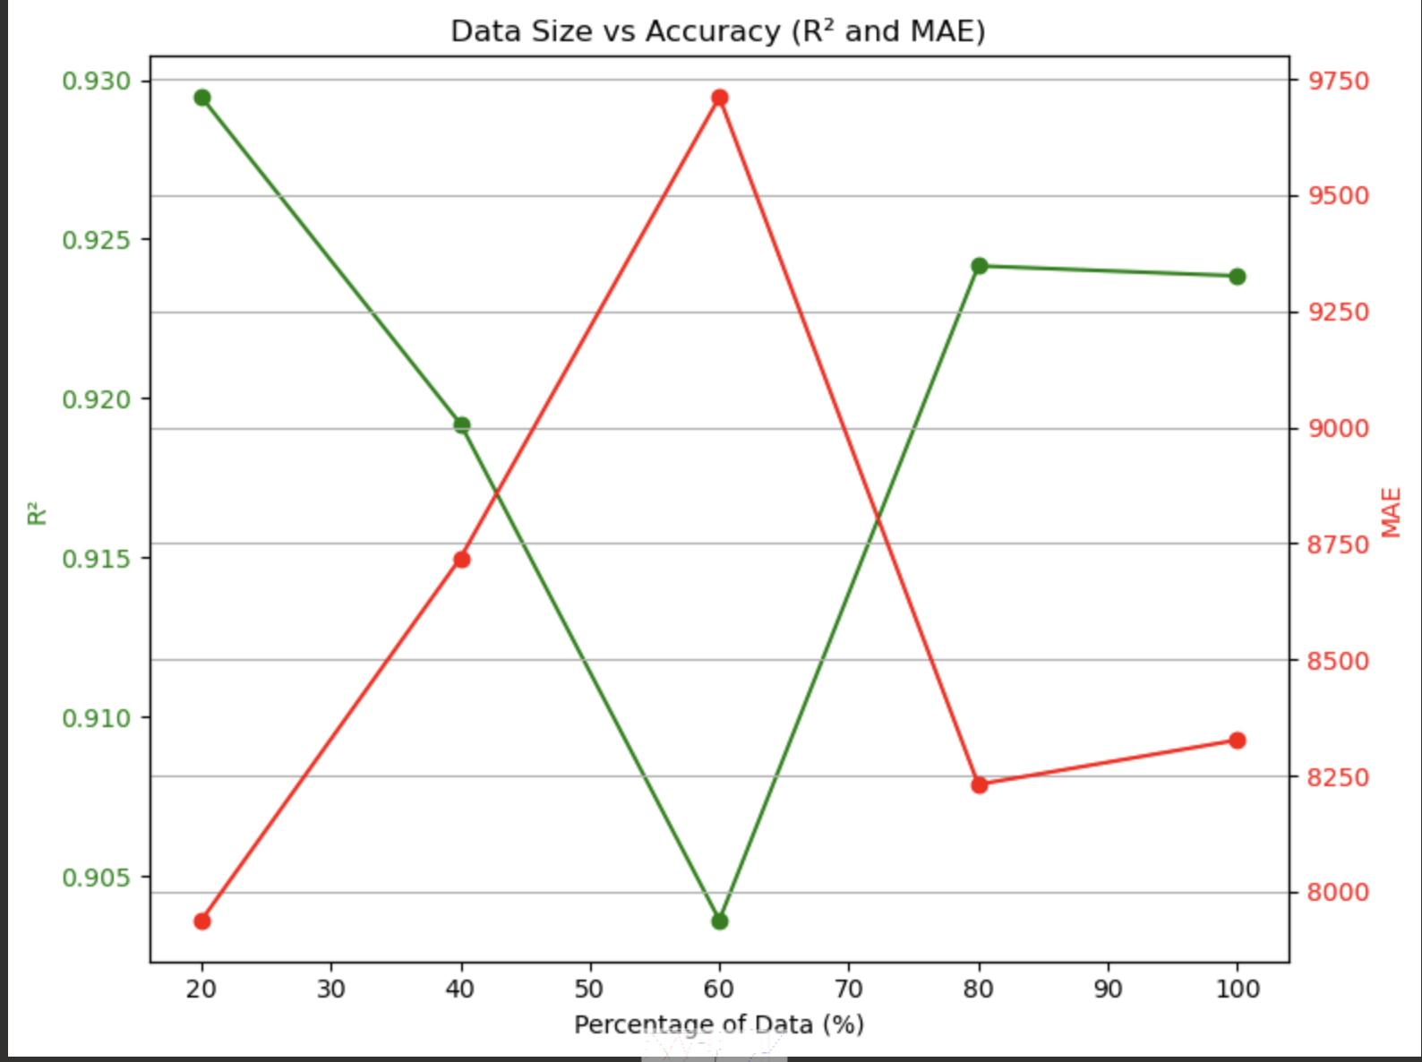
1 Master 3 Workers-Random Forest
Scaling out:
Scaling up:

Slide 20
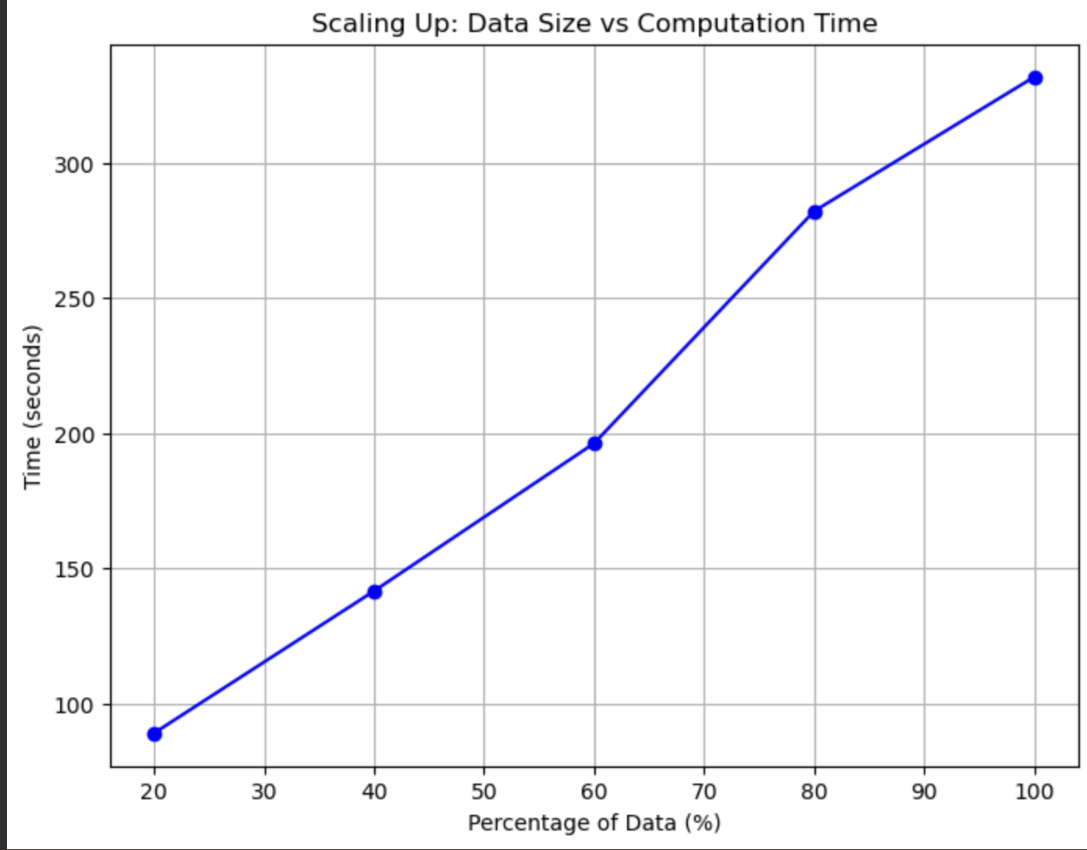
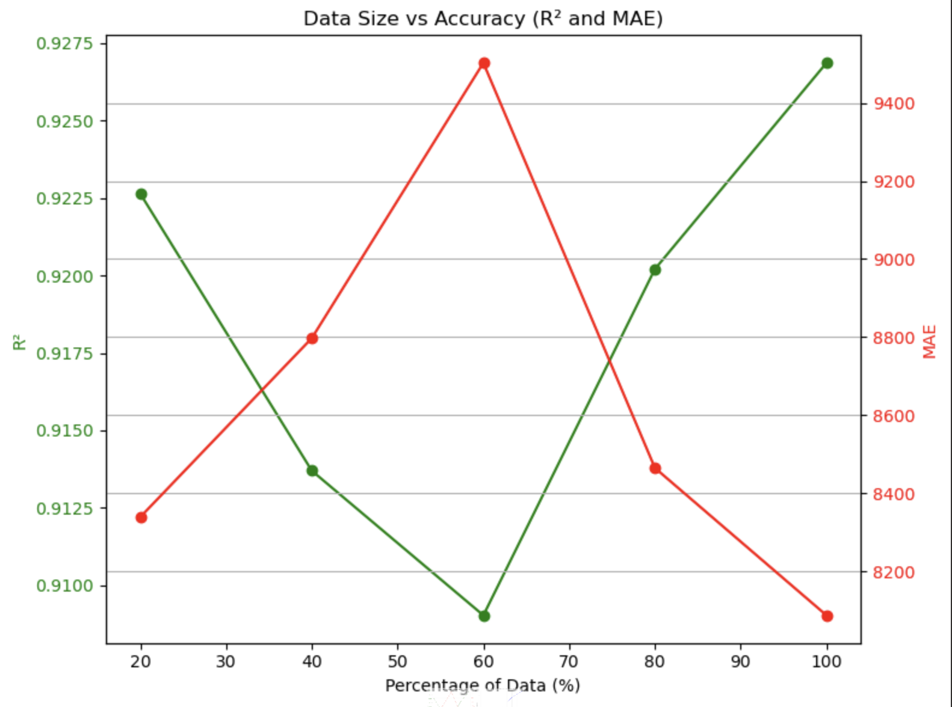
1 Master 4 Workers-Random Forest
Scaling out:
Scaling up:

Slide 21
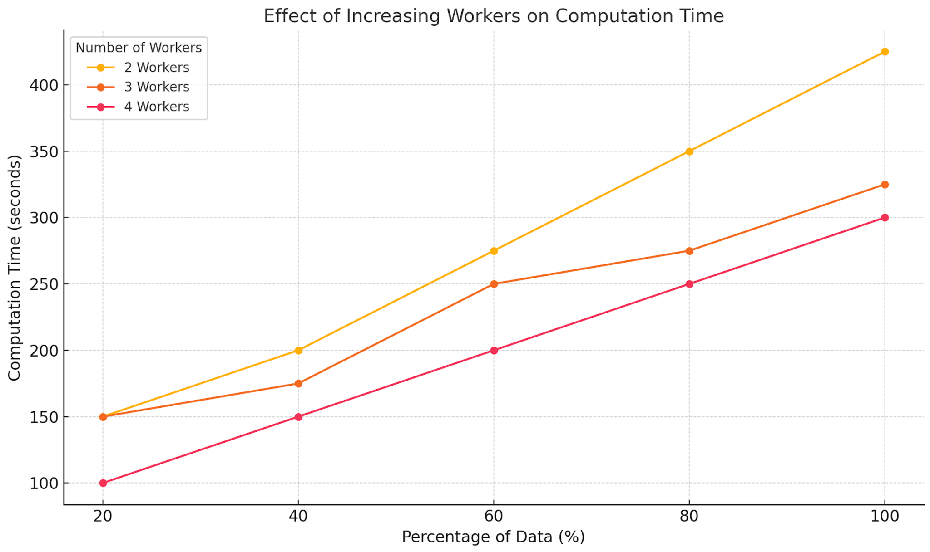
Conclusion
Computation Time vs. Data Size( Random Forest only)
Increasing the number of workers (2, 3, and 4 workers) consistently reduces computation time, with 4 workers being the most efficient.
Computation time grows with data size across all configurations, but the slope becomes less steep as more workers are added, demonstrating the efficiency of distributed computing.
The graph to the right indicates this and it only considers Random Forest.

Slide 22
THANK YOU!

